Slide 1
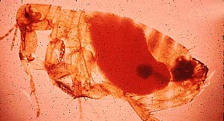

What has this got to do with the "Black Death?"

Slide 2
The Oriental Rat Flea!
The Oriental Rat Flea is a blood sucking parasite. They have the potential of spreading dangerous diseases to humans and other animals. It is possible the first Oriental Rat Flea was native to Asia and travelled by boat on the back of a rat to different destinations around the world.
The Oriental Rat Flea undergoes four different life cycles to become an adult. The Black Death, also known as the Bubonic Plague, is one of the deadly diseases that the Oriental Rat Flea can spread to man and animals.

Slide 3
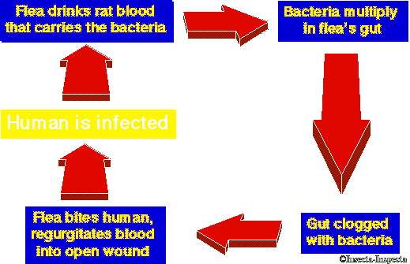

Slide 4
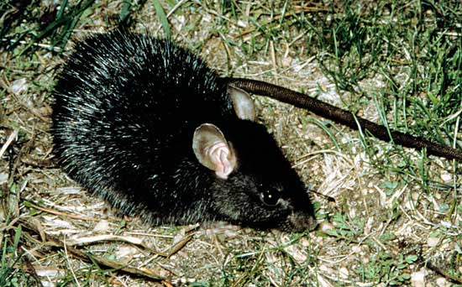
So who is responsible for spreading the "Black Death?"

Slide 5
The Black Rat !
If the plague had just stayed in one city, the containment might have spared Europe. Unfortunately, the plague spread when scared people fled to other cities, taking the infected Black Rats with them!
It is believed the plague originated in Asia, and moved west with armies and traders. The plague travelled via trade routes of ships and caravans, which the Black Rats could hide in.
Its path of death was generally from south to north and east to west passing through Italy, France, England, Germany, Denmark, Sweden, Poland, Finland, and eventually reaching Greenland.

Slide 6

Now test yourself!
What insect helped to spread the “Black Death?”
What is another name for the “Black Death?”
What rodent helped to spread the “Black Death?”
How did people help to spread the “Black Death?”

Slide 7
Aims of the Lesson:
To understand what really caused the “Black Death.”
To explain how the “Black Death” spread across Europe so quickly.

